Slide 1

Before starting today’s lesson, please take a few minutes to fill out the student survey for this module.
Use the link below to access the survey and write about all the beautiful things that you've learnt in this module so far :)
https://tees.surveys.evasysplus.co.uk/
Thank you for your time,
The Teaching Team

Slide 2
ICA Focus: Writing a Business Report

Slide 3
Today’s plan
How to write a business report
ICA Recap – Download the ICA document from Blackboard (Assessment)
Where to find the list of datasets
Q&A (going through your questions)
What if my dataset doesn’t have missing values?
How can I deal with missing values
How can I add a Calendar table/column?
Can I add extra column to the dataset?
How can I have the slicer acting only on one visual?
What if I notice half-way through the ICA that I need a new pre-processing step?
How can we deal with blanks?

Slide 4
ICA
Let’s open the ICA Document from Blackboard
Assessment\ICA Document

Slide 5
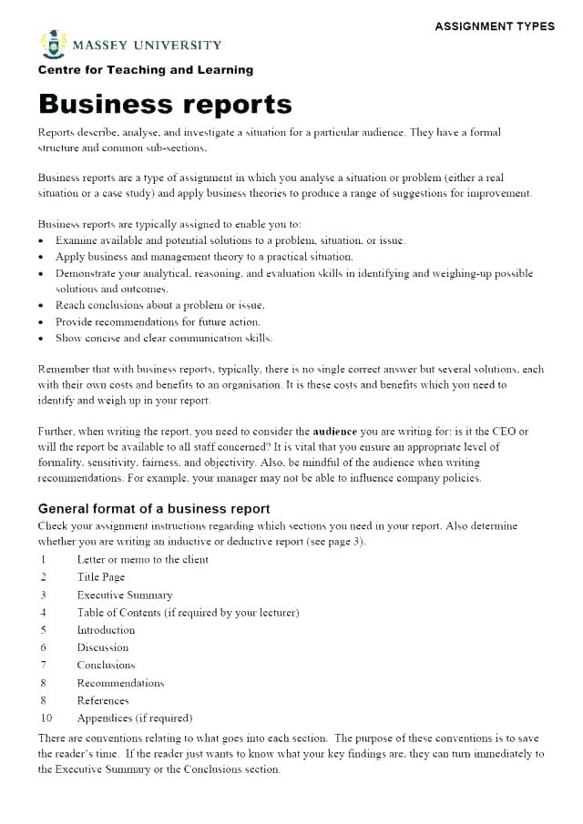
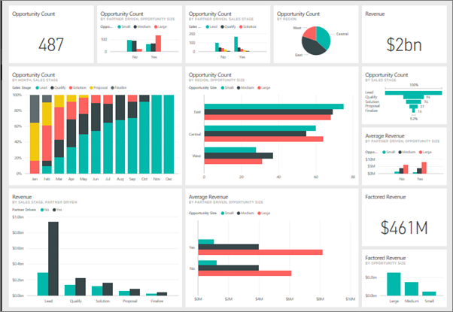
Writing a Business Report

Slide 6
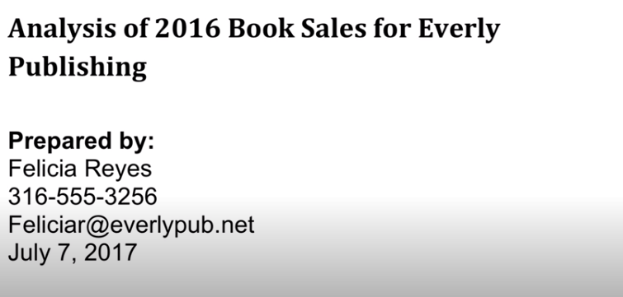
What is a Business Report?
Link to video: https://www.youtube.com/watch?v=Sq2SDdz1i8U

Slide 7
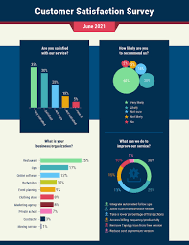
What are BR for?
Communicating information that can be acted upon
Examples:
To give some information about a particular topic that you have been asked to research
Report a collective analysis of where the business is at and where it’s going
Key part in the decision making process

Slide 8

Who are they for?
The decision makers are the audience
Examples:
For management or supervisors so that they can make decisions on them

Slide 9
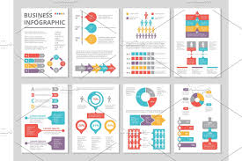
BR aims to
Answer a question
Solve a problem
Address an issue within the business
The report will show all the information, analyse and evaluate it and include recommendations for action
That’s why the structure of a BR is really important

Slide 10

How to Write a Business Report
What are they for?
Who are they for?
How to structure one?
Notes:
Normalization
Why normalization
https://www.youtube.com/watch?v=xoTyrdT9SZI
How to normalise
https://www.youtube.com/watch?v=mUtAPbb1ECM
https://launchschool.com/books/sql/read/table_relationships#normalization

Slide 11

How to structure a BR?
Title Page
Executive summary
Body
Introduction
Key findings based on data analysis
Conclusion
Recommendations

Slide 12
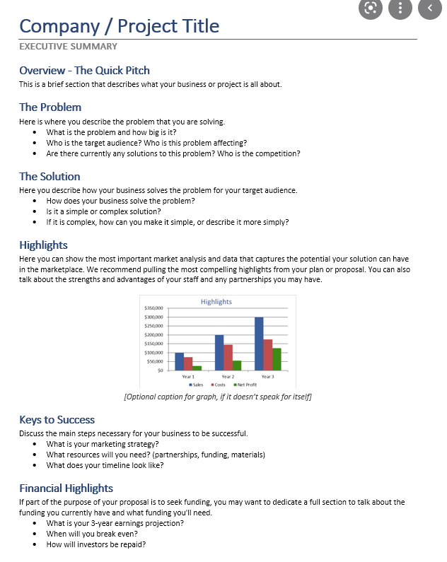
Executive summary
Cover letter
Bullet points on what’s the report about
What the main findings are and what is the general advice
Quick and easy to read
It’s a summary for the executive – busy people.
It’s the entire report in condensed form (background, key findings and recommendations).

Slide 13
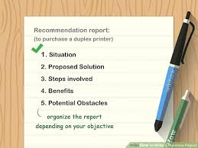
Body
Standard decision making process:
Introduction and background: State the problem. Identify the background or context to the problem presented
Key findings: Based on analysis and evaluation (Results from DAX/M Language calculations + Dashboard/Charts)
Conclusions: summarise and discuss the findings, with justifications for any suggestions

Slide 14


Recommendation
Bullet points list
Actions. What should be done next
Recommend solutions
Style of your report
Formal, logical, reporting all the facts.
No colloquial or first person.

Slide 15

Knowledge Check
In the first part of the ICA (Business Report) you need the following sections.
Place them in the correct order. Which one is missing?
Body/Findings
Conclusions And Recommendations
Title Page
Executive Summary

Slide 16
Best Practice for BI Reports
Why do you need this report?
Who will use this report?
Which metrics and Key Performance Indicators (KPIs) will you use for your business report?
What data will you need to add/remove from your current model?
Do you need to create new measures to measure those KPIs?
Notes:
https://blog.capterra.com/best-practices-for-better-bi-reports/

Slide 17
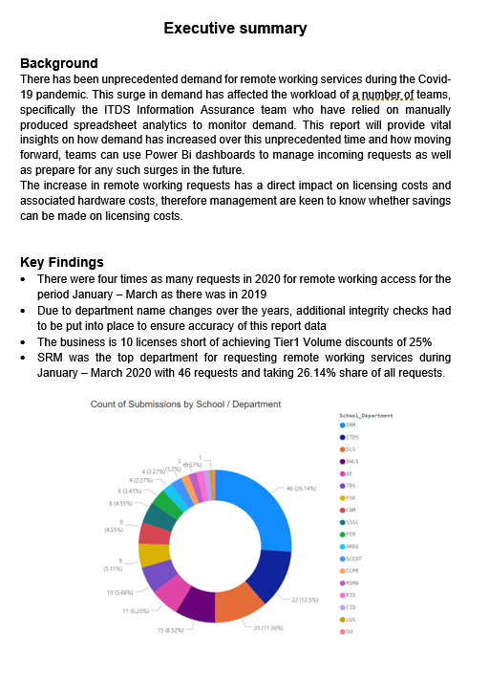
Example: BI Report
Example: Analysing demand for IT Remote Working services during the Covid-19 pandemic
Add titles to chart where appropriate
Explain what the chart is showing.
?

Slide 18

How many BI questions do you need?
At least three different BI questions
It’s not about the quantity, but the quality.
If you can answer those three questions simply by plotting a scatter chart, you’ll probably need more questions to show evidence of your Power BI skills.
Does your Business questions require any DAX calculation? Do you have enough numeric columns to do this?

Slide 19
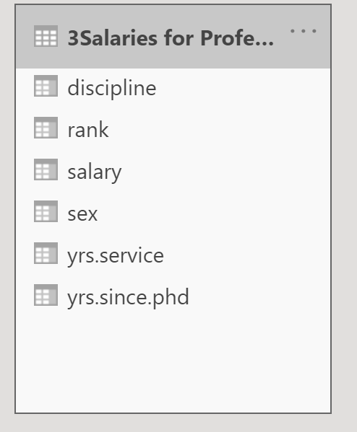
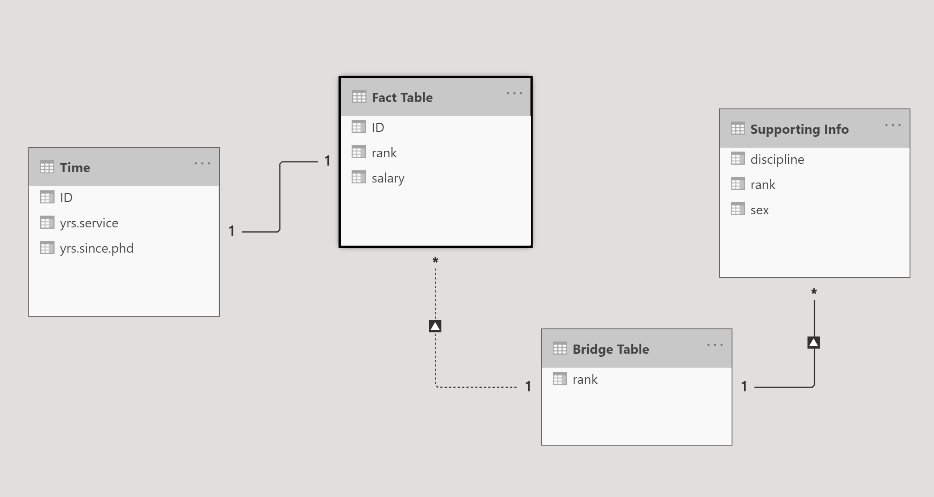
How can I do this?
Data pre-processing and modelling steps
How to split your table into smaller tables using the index column
How to merge your tables (for example if you’re using multiple tables and you want to repeat the splitting steps)
My dataset does not have any missing values. What can I do?
Re-watch the data modelling lesson (week 3) for more examples.

Slide 20
I can’t find a solution to my problem…
What should I do?
What should I write in my ICA?
Use the lesson material
Google your problem
Use the Power BI Community
Join Power BI groups on Facebook
Add evidence of the steps performed to solve your problems.
Even if you couldn’t find an appropriate solution, they will look good in your ICA
This will show that you have performed the required investigation steps to solve some issues with your dataset/ICA.
Getting errors/not being able to solve a problem is fine!
We only need to see what you did to try solving that problem.

Slide 21
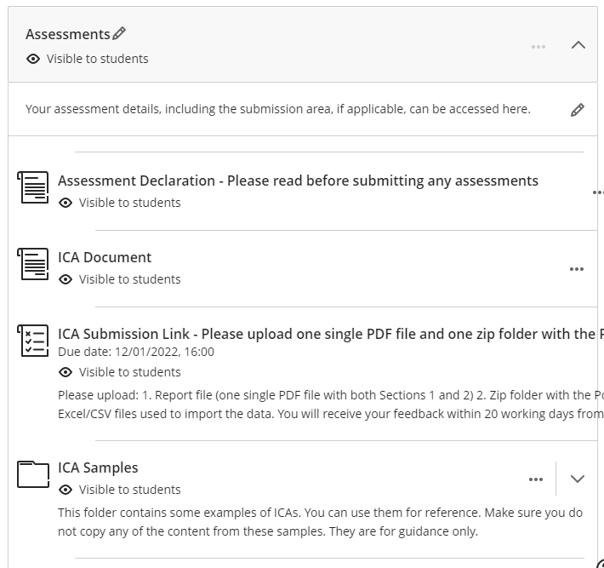
ICA Samples from last year
Use them to understand how to present your work/screenshots
Be careful: the structure required this year might be different from last year.
Refer to the ICA document to check the new requirements.

Slide 22
Where to find a dataset?
Check the link under Extra Resources

Slide 23
Quizziz
https://quizizz.com/admin/quiz/636cfd2fd2fb1c001e553279?source=quiz_share

Slide 24


Questions?
a.occhipinti@tees.ac.uk
If there is still time…otherwise in the following weeks…
What if my dataset doesn’t have missing values?
How can I deal with missing values
How can I add a Calendar table/column?
Can I add extra column to the dataset?
How can I have the slicer acting only on one visual?
What if I notice half-way through the ICA that I need a new pre-processing step?
How can we deal with blanks?
https://tees.surveys.evasysplus.co.uk/

Slide 25
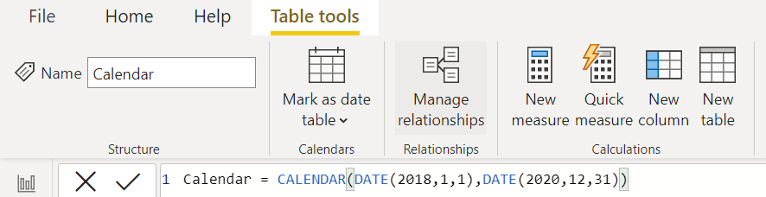
Adding a Calendar Table
How to add a calendar table and random dates

Slide 26
Use the notebooks on Kaggle to get more ideas
Get Inspired!
https://www.kaggle.com/lava18/google-play-store-apps

Slide 27
Links with more examples of BI Reports
https://www.datapine.com/blog/business-report-examples-and-templates/
https://www.matillion.com/resources/blog/dashboard-examples-the-good-the-bad-and-the-ugly
Extra reading on Business Reports with Examples
https://owll.massey.ac.nz/pdf/studyup-analyse-this-handout.pdfhttps://www.wgtn.ac.nz/__data/assets/pdf_file/0010/1779625/VBS-Report-Writing-Guide-2017.pdf
https://library.unimelb.edu.au/__data/assets/pdf_file/0005/1924160/Business_Reports.pdf
Example of a very long report https://www.cengage.com/bcomm/book_content/0324375530_lehman/model_documents/good_example_long_report.pdf

